Slide 1
Group velocity and Phase velocity

Slide 2

Phase Velocity
The phase velocity of a wave is the rate at which the phase of the wave propagates in space.
This is the velocity at which the phase of any one frequency component of the wave travels. For such a component, any given phase of the wave (for example, the crest) will appear to travel at the phase velocity.
The phase velocity is given in terms of the wavelength λ (lambda) and period T as

Slide 3

Or, equivalently, in terms of the wave’s angular frequency ω, which specifies the number of oscillations per unit of time, and wavenumber k, which specifies the number of oscillations per unit of space, by

Slide 4

Group Velocity
The group velocity of a wave is the velocity with which the overall shape of the wave’s amplitudes — known as the modulation or envelope of the wave — propagates through space.
The group velocity defined by the equation-

Slide 5
where ω is the wave’s angular frequency (usually expressed in radians per second), and k is the angular wavenumber (usually expressed in radians per meter). The function ω(k), which gives ω as a function of k, is known as the dispersion relation.
If ω is directly proportional to k, then the group velocity is exactly equal to the phase velocity. Otherwise, the envelope of the wave will become distorted as it propagates.
This “group velocity dispersion” is an important effect in the propagation of signals through optical fibers and in the design of high-power, short-pulse lasers.

Slide 6
To understand the difference between phase and group velocity of waves, consider the following analogy. A group of people, say city marathon runners, start from the starting at the same time. Initially it would appear that all of them are running at the same speed. As time passes, group spreads out (disperses) simply because each runner in the group is running with different speed. If you think of phase velocity to be like the speed of individual runner, then the group velocity is the speed of the entire group as a whole. Obviously and most often, individual runners can run faster than the group as a whole. To stretch this analogy, we note that the phase velocity of waves are typically larger than the group velocity of waves. However, this really depends on the properties of the medium.

Slide 7
Briefly, phase velocity refers to a monochromatic wave, let’s say, the velocity of one of the peaks of the wave. For example, a monochromatic wave with angular frequency ω = 2πν (ν is the frequency) travelling in +ve x-direction is given by,
y = A sin(ωt − kx).
On the other hand, group velocity refers to a group composed of waves within a frequency band.

Slide 8
In quantum physics, a group of waves can be associated with a material particle (De Broglie’s hypothesis). If the particle is moving with speed v << c, then the wavelength of wave group associated with the particle is λ = h/mv, where h is Planck’s constant. If y(x) represents one such wave group, then |y(x)|² gives the probability density for finding the particle in the range x and x+dx. Further, it can also be shown that the group velocity v_{g} = v. Since the information on the position and velocity of the particle can be obtained from y(x), this represents the state of the particle.

Slide 9
The amplitude of the de Broglie waves that correspond to a moving body reflects the probability that it will be found at a particular place at a particular time. It is clear that de Broglie waves cannot be represented simply by a formula resembling Eq.
which describes an indefinite series of waves all with the same amplitude A.

Slide 10
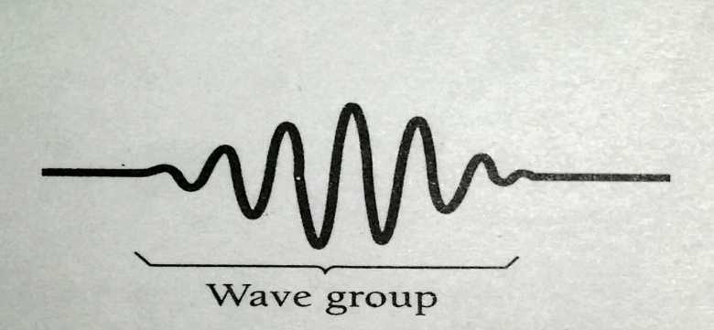
Instead, we expect the wave representation of a moving body to correspond to a wave packet, or wave group, like that shown in Fig. below:
whose waves have amplitudes upon which the likelihood of detecting the body depends.

Slide 11
A familiar example of how wave groups come into being is the case of beats. When two sound waves of the same amplitude but of slightly different frequencies are produced simultaneously, the sound we hear has a frequency equal to the average of the two original frequencies and its amplitude rises and falls periodically.

Slide 12
The amplitude fluctuations occur as many times per second as the difference between the two original frequencies. If the original sounds have frequencies of, say, 440 and 442 Hz, we will hear a fluctuating sound of frequency 441 Hz with two loudness peaks, called beats, per second. The production of beats is illustrated in Fig.

Slide 13
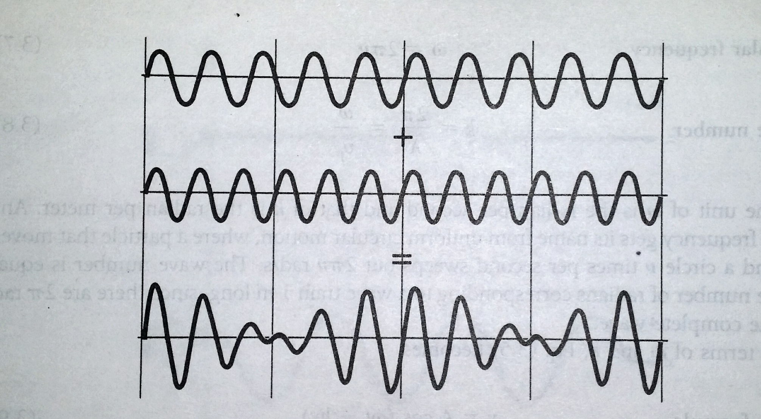

Slide 14
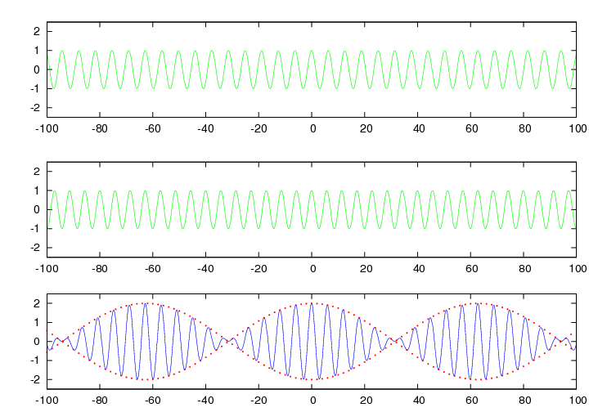

Slide 15
A way to mathematically describe a wave group, then, is in terms of a superposition of individual waves of different wavelengths whose interference with one another results in the variation in amplitude that defines the group shape.

Slide 16
The group velocity of a wave is the velocity with which the variations in the shape of the wave's amplitude (known as the modulation or envelope of the wave) propagate through space.
The phase velocity of a wave is the rate at which the phase of the wave propagates in space. This is the velocity at which the phase of any one frequency component of the wave will propagate. You could pick one particular phase of the wave (for example the crest) and it would appear to travel at the phase velocity.

Slide 17
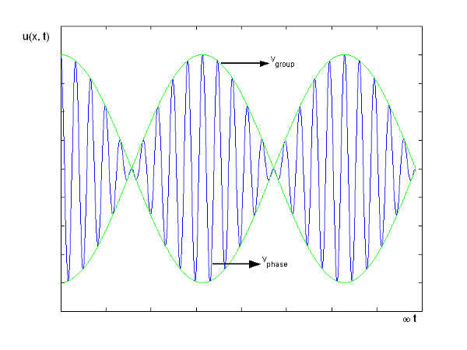

Slide 18
If the velocities of the waves are the same, the velocity with which the wave group travels is the common phase velocity. However, if the phase velocity varies with wavelength, the different individual waves do not proceed together. This situation is called dispersion. As a result the wave group has a velocity different from the phase velocities of the waves that make it up. This is the case with de Broglie waves.

Slide 19
Let us suppose that the wave group arises from the combination of two waves that have the same amplitude A but differ by an amount Δω in angular frequency and an amount Δk in wave number. We may represent the original waves by the formulas:

Slide 20

The resultant displacement y at any time t and any position x is the sum of y₁ and y₂. With the help of the identity:
We know that:

Slide 21
=

Slide 22

Since Δω and Δk are small compared with ω and k respectively,
Thus:

Slide 23
This equation represents a wave of angular frequency ω and wave number k that has superimposed upon it a modulation of angular frequency and of wave number .

Slide 24


Phase velocity is given by:
Group velocity is given by:

Slide 25

When ω and k have continuous spreads instead of the two values in the preceding discussion, the group velocity is instead given by:

Slide 26
Depending on how phase velocity varies with wave number in a particular situation, the group velocity may be less or greater than the phase velocities of its member waves. If the phase velocity is the same for all wavelengths, as is true for light waves in empty space, the group and phase velocities are the same.

Slide 27






The angular frequency and wave number of the de Broglie waves associated with a body of mass m moving with the velocity ν are

Slide 28

Both ω and k are functions of the body’s velocity ν.
The group velocity ν_{g} of the de Broglie waves associated with the body is

Slide 29



Slide 30
And so the group velocity turns out to be
The de Broglie wave group associated with a moving body travels with the same velocity as the body.

Slide 31

The phase velocity of de Broglie waves is, as we found earlier,

Slide 32
This exceeds both the velocity of the body ν and the velocity of light c, since ν<c. However, ν_{p} has no physical significance because the motion of the wave group, not the motion of the individual waves that make up the group, corresponds to the motion of the body, and ν_{g}<c as it should be. The fact that ν_{p}>c for de Broglie waves therefore does not violate special relativity.

